Slide 1
BIHL Group Results
For the year ended 31 December 2012

Slide 2
AGENDA
Welcoming Remarks – Batsho Dambe-Groth
BIHL Financial Results – Gaffar Hassam
BIHL Embedded Value – Sethunya Molosiwa
Questions

Slide 3
Welcoming Remarks
Batsho Dambe-Groth
BIHL Group Board Chairperson

Slide 4
Overview of the Operations and Results
for the year ended
31 December 2012
Gaffar Hassam
Group Chief Executive Officer

Slide 5
Headlines for 2012
Decrease in Operating profits & Core earnings
Increase in AUM and EV
Decrease in VNB
Higher ROGEV
Highlights
Pressure on household incomes
International
Equity markets
volatility
Lower Interest rates
Macro
Themes
Improving global economic data
Strategic Delivery
Subsidiary Market share protection and growth
Capitalise on group synergies
New segment penetration & new products to market
Regional Expansion & New Investments locally financial services industry

Slide 6
Headlines for 2012 – Macro Themes
Macro
Themes
Challenging Economic Conditions

Slide 7
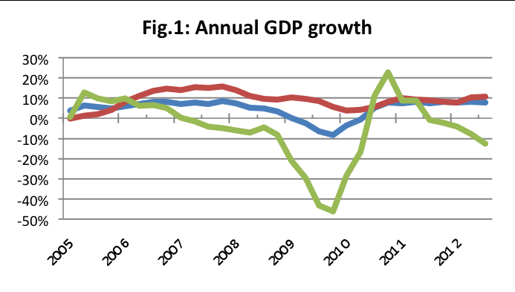
GDP Growth: (Q3 2012)
Source: Statistics Botswana, Econsult
--- GDP --- Non-mining Private Sector --- Mining

Slide 8
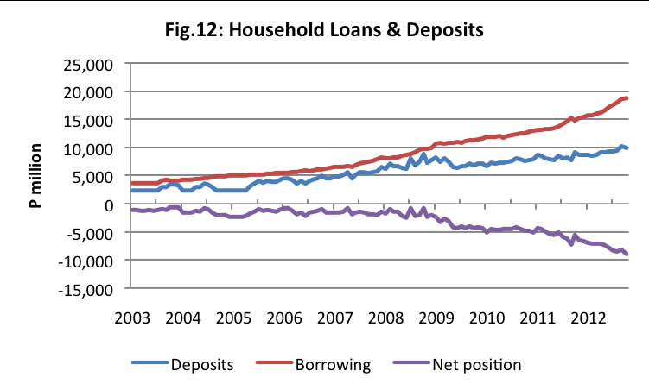
Household Deposits & Borrowing
Source: Bank of Botswana, Econsult

Slide 9
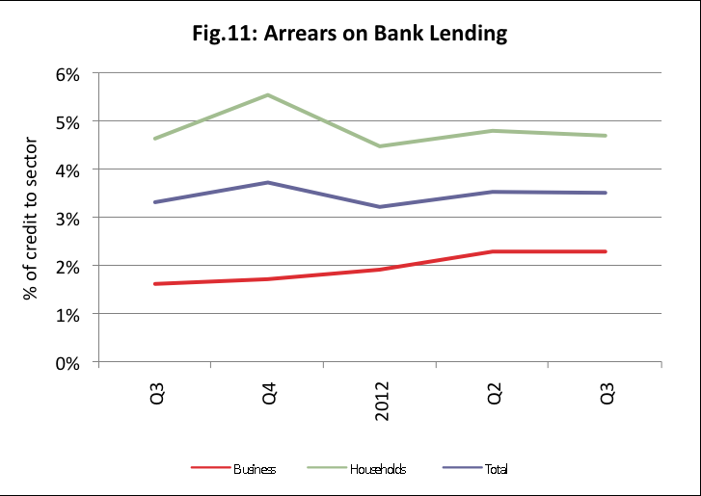
Bank lending arrears
Source: Bank of Botswana, Econsult

Slide 10
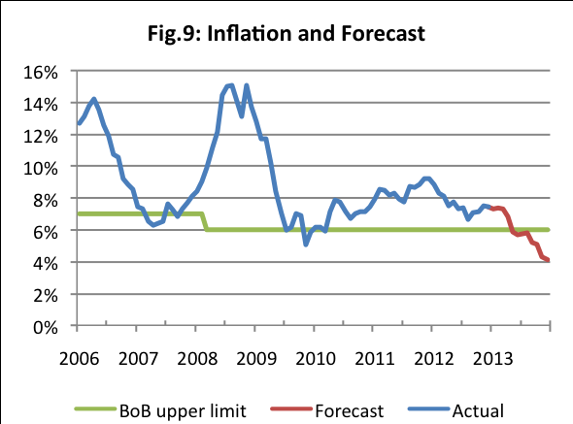
Inflation and forecast
Source: Statistics Botswana, Bank of Botswana, Econsult

Slide 11
Headlines for 2012 – Strategic Delivery
Key objective: Maximising shareholder value(growth, diversification, cost management)
Highlights

Slide 12
Strategic Focus on Returns
Maximise profitable growth
Maximise capital efficiencies
Net Business Flows
Growth/ Earnings
Diversification
Returns
(ROGEV)
2012: 13%
2011: 8%
Operational Efficiencies
Optimal application
Capital Efficiency
Strategic Investments
Return of Excess

Slide 13
BIHL GROUP – High Level Structure
BIHL
(53% Sanlam, 43% Publicly held on BSE)
BLIL
(100%)
Bifm
(100%)
BIHL Sure!
(100%)
Associates
(25.33% Letshego, 28.65% FSG, 62.9% KYS, 49% Aflife Zambia)
“STRENGTH IN NUMBERS”

Slide 14
BIHL GROUP
FINANCIAL REVIEW……STRENGTH IN NUMBERS

Slide 15
Revenue
 | Year ended December 2012 |  | Year ended December 2011 |  | % change
 | P’000 |  | P’000
Premium income | 1 949 585 |  | 1 767 046 |  | 10%
- Recurring - Single - Premiums ceded to reinsures | 908 800 1 061 613 (20 828) |  | 894 827 887 226 (15 007) |  | 2% 20%
Fee income | 74 700 |  | 110 944 |  | (33%)
Investment income | 442 563 |  | 749,577 |  | (40%)
Profit on sale of subsidiary | - |  | 33 785 |  | -
Net investment surpluses | 645 344 |  | 134,323 |  | 380%
Total | 3 112 192 |  | 2 795 675 |  | 11%

Slide 16
Revenue continued
Premium income increased due to
Retention of clients;
Stabilisation of lapses
Increase in annuity income
Fee income
Fee income decreased by 33% due to sale of Zambia, however increase in AUM
Investment income
Decreased by 40%
Investment surplus
Increased by 380%

Slide 17
Analysis of earnings
 | Year ended December 2012 P’000 | Year ended December 2011 P’000 | % change
Operating profit | 232 764 | 273 146 | (15%)
Investment income | 44 031 | 30 612 | 44%
Core earnings | 276 795 | 303 758 | (9%)
Profit on sale of subsidiary | - | 33 785
Share of profits of associates and Jv’s | 196 482 | 133 872 | 47%
Investment gains on shareholder assets | 12 054 | 56 998 | (79%)
Profit before tax | 485 331 | 528 413 | (8%)
Tax | (90 936) | (57 083) | 59%
Profit after tax | 394 395 | 471 330 | (16%)

Slide 18
Operating Profit
15% decrease
Pressure on household disposable incomes
Sale of the 21% held in our Zambian associate;
Increased costs of regulatory compliance;
Expansion into short term industry;
Investments in improved IT systems to further improve customer service.
Share of profits of associates
47% increase
Increased stake in associates
Good underlying performance.

Slide 19
Cashflows
 | Year ended December 2012 P’000 |  | Year ended December 2011 P’000 | % change
Cash flows from operating activities | 2 534 022 |  | 335 820 | 655%
Cash flows utilised in investing activities | (3 022 083) |  | (463 448) | 552%
Net decrease in cash and cash equivalents | (488 061) |  | (127 628) | 282%
Cash and cash equivalents at the beginning of the year | 1 248 600 |  | 1 376 228 | 9%
Cash and cash equivalents at the end of the year | 760 539 |  | 1 248 600 | (39)%

Slide 20
Cashflows
39% decrease
Healthy balance of P761million;
Decreased from P1.2billion due to deployment in investments
After payment of dividend of P157.4 million.

Slide 21
Three year review
 | Year ended December 2012 | % Change | Year ended December 2011 | % Change | Year ended December 2010 | % Change | Year ended December 2009
 | P’000 |  | P’000 |  | P’000 |  | P’000
Net premium income | 1 949 585 | 10% | 1 767 046 | 9% | 1 620 513 | 29% | 1 253 413
Fee income | 74 700 | (33%) | 110 944 | (19)% | 137 250 | 14% | 120 623
Profit after tax | 394 395 | (16%) | 471 330 | 42% | 332 482 | 40% | 237 673
VNB | 99 307 | (14)% | 115 305 | (13)% | 132 346 | 16% | 113 602
Inv. Income | 44 031 | 44% | 30 612 | (58)% | 73 257 | 28% | 57 397
Inv. surpluses/ (losses) | 12 054 | (79%) | 56 998 | 217% | 17 985 | 184% | (72 412)

Slide 22
Three year review 2009-12

Slide 23
Financial Position
Dec 2012 Dec 2011 %
Total assets (P billion) 15.42 12.73 21
EV (P billion) 2.58 2.41 7
Required capital (times) 6.8 5.9 15
AUM (P billion) 21.61 17.82 21
The above is after dividend payment
of (P million) 157 400 185 520

Slide 24
Financial Position
Strong position, capital required well covered
Readily available financial resources
Leverage on financial position for growth and diversification

Slide 25
Dividends
 | Year ended December 2012 | Year ended December 2011
Dividend per share (gross of tax)
Normal interim (paid) (thebe) Normal final (thebe) Total normal dividend (Pm) | 15.00 20.00 157.4 | 25.00 41.00 185.6
Number of issues shares (million) | 281 | 281
Number of shareholders | 3 014 | 3 144

Slide 26
Business Flows
 |  | Dec 2012 P’000 |  | Dec 2011 P’000 | % change
Life Insurance business:
Recurring Single |  | 136 049 1 062 581 |  | 210 222 855 928
Total new business |  | 1 198 630 |  | 1 066 151 | 12%
Recurring Single |  | 716 203 (967) |  | 541 959 (4 432)
Total existing business |  | 715 236 |  | 537 527 | 33%
Outflows |  | (887 623) |  | (695 827) | 28%
Net funds flows |  | 1 026 243 |  | 907 851 | 13%

Slide 27
Business Flows
 |  | Dec 2012 P’000 |  | Dec 2011 P’000 | % change
Asset Management business:
Inflows Outflows |  | 1 092 850 (674 515) |  | 687 931 (2 012 174) | 59% (66%)
Net funds flows |  | 418 335 |  | (1 324 243) | (132%)
Total Net funds flows (Life and asset management) |  | 1 444 578 |  | 1 076 547 | 34%

Slide 28
STRATEGIC FOCUS & PROSPECTS FOR 2013

Slide 29
To be a significant regional financial services provider through optimisation of the Group's collective strength (ROGEV)
New Investments
Group Synergies
(based on strong subsidiaries)
Operational Efficiencies
People
Governance Risk Management Corporate Citizenship
Integrity Team Work Service Excellence Innovation

Slide 30
Key Priorities for 2013
Focus areas to deliver sustainable growth:
Market share protection and growth (being relevant to our customers)
BIHL Sure market penetration
New products to market
Capitalize group synergies
Investments in financial services industry
Unit trusts launch in April

Slide 31
Strategic Goals for…..Operations
Delivering sustainable growth
Client retention
Cost management
Continuous improvement to enhance efficiencies
High performance culture

Slide 32
Key Priorities for 2013
Some key Initiatives during the year:
Launch new retail products (this includes Unit trust)
Exploit new technological platforms
Increase short term business market share
Continued focus on client retention

Slide 33
OUTLOOK

Slide 34
Outlook for 2013
Business Environment:
Uncertainty in the global financial markets (risk aversion)
Retail customer remains under pressure
Implications of regulatory changes
Challenges:
Effective and efficient redeployment of discretionary capital
Customer retention
Cost Control
Profitable growth opportunities
However business has the people, financial resources and the courage to face these challenges.

Slide 35
Summary
• Strategic objectives are being achieved:

Slide 36
Thank you

Slide 37
Analysis of Embedded Value Earnings
Sethunya Molosiwa, 7 March 2013

Slide 38
Embedded Value

Slide 39
Embedded Value
Components of Embedded Value
Excess of market value of assets over liabilities
Discounted value of future profits from existing business
Adjusted for tax and cost of capital

Slide 40
Embedded Value
 | Dec’12 Pm | Dec’11 Pm | Dec’10 Pm
Net asset value | 2,040 | 1,911 | 1,867
Value of in force | 537 | 499 | 540
Embedded value | 2,577 | 2,410 | 2,406
Embedded Value increased by 7% over the year to Dec 2012
Embedded value per share increased from P9.07 to
P9.61

Slide 41
Embedded Value Earnings

Slide 42
Embedded Value Earnings
 | Dec’12 Pm | Dec’11 Pm | Dec’10 Pm
Closing EV | 2,577 | 2,410 | 2,406
Opening EV | 2,410 | 2,407 | 2,221
Change in EV | 167 | 3 | 186
Dividends paid | 157 | 186 | 216
EV Earnings | 324 | 189 | 402

Slide 43
Embedded Value Earnings
 | Dec’12 12 months | Dec’11 12 months | Dec’10 12 months
Expected return on life business in force | 80.2 | 81.4 | 81.7
Value of new business | 99.3 | 115.3 | 132.3
Operating experience variances | 7.6 | 10.4 | 60.8
Operating assumption changes | 18.1 | (37.7) | (32.2)
Investment variances and assumption changes | 28.3 | (6.0) | 3.2
Return on shareholders’ assets | 224.4 | 319.2 | 102.5
Change in shareholders’ fund adjustments | (133.6) | (294.1) | 53.7
Embedded value earnings | 324.3 | 188.6 | 402.0
RoEV | 13% | 8% | 18%

Slide 44
Embedded Value Earnings
Operating Experience Variances
 | Dec’12 12 months | Dec’11 12 months | Dec’10 12 months
Mortality & Morbidity | 58.7 | 45.5 | 38.8
Persistency | (24.0) | (14.0) | (9.1)
Expenses | (6.9) | 3.5 | 6.1
Other | (20.3) | (24.5) | 25.0
Total | 7.6 | 10.4 | 60.8

Slide 45
Embedded Value Earnings
Operating Assumption Changes
 | Dec’12 12 months | Dec’11 12 months | Dec’10 12 months
Mortality & Morbidity | 6.7 | (27.5) | 0.0
Persistency | 45.8 | (26.7) | (16.2)
Expenses | (14.0) | 1.3 | (7.0)
Other | (20.3) | 15.3 | (9.0)
Total | 18.1 | (37.7) | (32.2)

Slide 46
Embedded Value Earnings
Operating Assumption Changes
Other
(P20.3m)
Lower premium collection
Annuity 2nd tier margins
Annuity mismatch reserves

Slide 47
Embedded Value Earnings
Investment Variances and Assumption Changes
 | Dec’12 12 months | Dec’11 12 months | Dec’10 12 months
Investment Variances | 17.8 | (6.0) | (12.9)
Assumption Changes | 10.5 | 0.0 | 16.1
Total | 28.3 | (6.0) | 3.2

Slide 48
Embedded Value Earnings
Return on Shareholders’ Assets
 | Dec’12 12 months | Dec’11 12 months | Dec’10 12 months
Investment Returns | 57.7 | 154.1 | (9.1)
Net profit non-life operations | 166.7 | 165.0 | 111.6
Total | 224.4 | 319.2 | 102.5

Slide 49
Embedded Value Earnings
Change in Shareholders’ Fund Adjustments
 | Dec’12 12 months | Dec’11 12 months | Dec’10 12 months
Changes in treasury share adjustments | 0.0 | 0.0 | (10.5)
Movement in present value of holding company expenses | (8.9) | (14.3) | (8.0)
Movement in fair value of incentive scheme shares | 1.4 | (26.1) | (17.4)
Movement in other net worth adjustments (Reversal of cross holding adjustment + Write up of non-life operations to fair value) | (126.1) | (253.7) | 89.6
Total | (133.6) | (294.1) | 53.7

Slide 50
Embedded Value Earnings

Slide 51
Capital Requirements & Solvency

Slide 52
Capital Requirements
CAR as prescribed in SA insurance regulation
Consistent with Prescribed Capital Target (BPCT)
CAR calculation determines the minimum capital required
All policies terminate (TCAR)
Compound effect of various risks (OCAR)
(eg. investment, expenses, termination)

Slide 53
Solvency
 | Dec’12 | Dec’11 | Dec’10
 | Pm | Pm | Pm
NAV | 2,040 | 1,911 | 1,870
VIF | 537 | 499 | 540
Embedded value | 2,577 | 2,410 | 2,409
Required Capital | 279 | 258 | 263
Required Capital cover | 6.8 | 5.9 | 5.8

Slide 54
Thank You

